Slide 1
Data Integrity (For Management Personnel)
GMP Expert Committee, Quality and Technology Committee, Japan Pharmaceutical Manufacturers Association
DI Project - Prepared in May 2019

Slide 2
Table of Contents
Data Integrity - Why must we comply with this? –
Image and Definition of Data Integrity
Data Governance Systems
Organizational Impact
General Impact
Code of Ethics and Quality Culture
PQS Elements

Slide 3
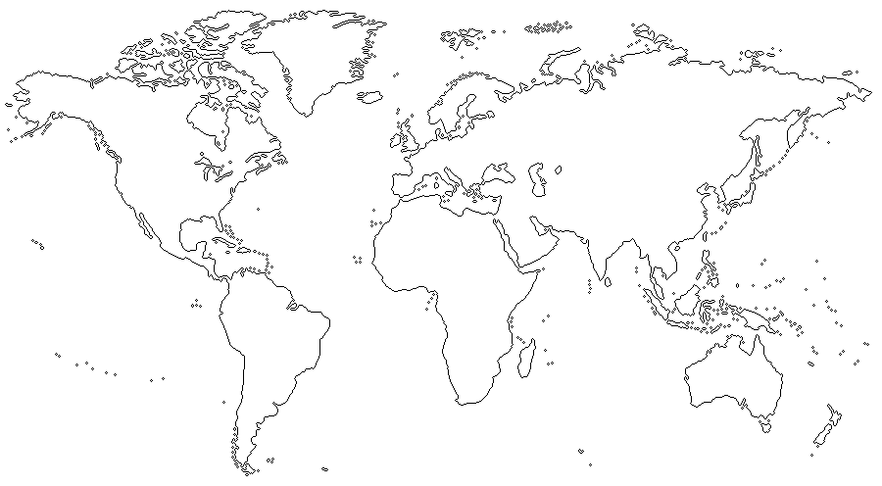


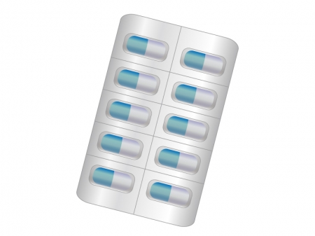
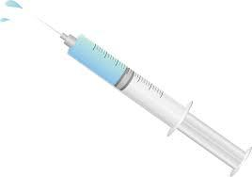


Data Integrity – Why must we comply with this? –
Reliability
Patients and medical institutions
Marketing authorization holder (MAH)
- 3 -
Notes:
No one can know the true quality of each individual drug product. It is difficult to judge the quality of drugs based on their appearance. However, patients and medical institutions that use the products we manufacture and sell have faith in their quality. They never question whether the products were manufactured by the correct procedure or actually contain the active ingredient. In other words, patients and medical institutions trust us as manufacturers and marketers of drugs.
How do we prove ourselves worthy of this trust as manufacturers and marketers of drugs?

Slide 4




Data Integrity – Why must we comply with this? –
Comparison of quality assurance methods
Consumers
Home appliances, etc.
Inspection result: Conforming
Functional testing of all items
100,000 units manufactured
5 non-conforming units ⇒ These are not placed on the market
Consumers can perceive quality defects when they use the product.
Testing and inspection of some of the tablets
All are guaranteed by data.
Some are lost due to destructive testing.
Test results: Conforming
Pharmaceutical products, etc.
500 tablets for testing
Patient
999,500 tablets
1 million tablets manufactured
Quality defects that patients can perceive are limited to appearance, taste, smell, etc.
Patients would are not be able to tell even if the drug product contains only half of the specified amount of API or it is contaminated with other ingredients.
- 4-
Notes:
In brief, what we have done thus far is to test samples of the drugs we manufacture and market – the drugs that are delivered to patients and medical institutions. These test samples are taken from the entire population of products and the quality of products has been guaranteed with the data from these samples. However, since the samples are destroyed through the test, the samples themselves that passed the test cannot be delivered to patients and medical institutions.
If only visual inspection were sufficient, 100% inspection would be possible for drugs, but the physicochemical tests that correspond to functional inspection are performed only for the samples collected (test samples), that is, drug products representing that particular lot.
In other words, the individual products that can be delivered to patients and medical institutions are, in a sense, "untested products." Due to their characteristics, the quality of the drugs that can be delivered to patients and medical institutions is may be said to be guaranteed by various records (data), such as manufacturing and test records.
In this sense, ensuring the integrity, consistency, and accuracy of records (data) related to drugs is a commitment to patients and medical institutions.

Slide 5



Data Integrity – Why must we comply with this? –
Follow procedures
Perform the operations
At the same time
Leave contemporaneous records
Records (data) . . . are the only proof that the operations were performed in accordance with the procedures.
It makes it possible to track operations.
Complete, consistent and accurate records (data) demonstrate the quality of the products we deliver to the market and earn the trust of patients and medical institutions!
- 5-
Notes:
"Why is data integrity necessary? Why must we take steps to ensure that data are complete, consistent and accurate?"
These are necessary in order to faithfully fulfill the aforementioned commitment to patients and medical institutions.
As you know, all decisions regarding the manufacture and marketing of medicinal products are based on data.
This practice is built on the fundamental philosophy that [1] data (records) are evidence of review (inspection) of drugs and [2] data (records) are evidence of the quality of drugs.
Records (data) are the only proof that we performed the work in accordance with the procedures, and they certify "when, who, where, what and how." If there are no records (data) or if they are not correct, the work was "not performed." Writing results on paper in real time or entering them into computers, etc. is necessary in order to steadily fulfill our commitment to patients and medical institutions and be worthy of their trust.
If the data submitted in the application (inspection), etc. are incorrect or if the quality test data are improperly prepared, a drug with deficiencies in efficacy and safety will be approved and distributed to the market, and this situation will inevitably present a major problem, not only for pharmaceutical companies but also for the regulatory authorities as well as for patients and medical institutions.
That is why we must ensure product quality by promoting data integrity, through the creation of a GMP organization and cooperation between the employees and the company (management) in keeping records correctly.

Slide 6


Data Integrity – Why must we comply with this? –
Start
Late 1980s Generic Drug Scandal
=> It was revealed that the wrong data were provided by a pharmaceutical company in connection with bribery!
=> This led to enormous fines, impact on stock prices, and obstacles to business operations! !
Early 1990s Application Integrity Policy (FDA)
=> Guideline on Integrity of Application Data issued!
After 2010 Expanded scope of data integrity! (FDA)
=> More rigorous inspections for API plants in India and China, which are major suppliers for US products!
Quality cannot be guaranteed at companies that cannot produce correct data. Defects at suppliers directly lead to products stockout.
- 6-
Notes:
The Generic Drug Scandal that occurred in the United States in the late 1980s was exactly such a situation in which the reliability of data was compromised.
https://www.nytimes.com/1989/10/02/opinion/the-generic-drug-scandal.html
https://www.slideshare.net/mswit/a-fda-crisis-history-the-generic-drug-scandal
Below are the consequences from this scandal (including the financial impact from the loss of data (value at the time).
Loss of sales: $102,000,000 (1989), $55,000,000 (1990)
Employee dismissals: Staff reduced from 900 persons to 450 persons
Criminal and civil fines:$2,750,000
Settlement for shareholder lawsuits:$2,250,000
External auditors and attorneys' fees: Up to $5 million
Disruption of business operations (4 years’ worth of research and development expenses): Incalculable
Civil litigation costs:~$13,000,000
In the late 1990s, "Guidance on the Integrity of Application Data" were issued following the above-mentioned scandal.
https://www.fda.gov/ICECI/EnforcementActions/ApplicationIntegrityPolicy/default.htm
In addition, since 2010, the FDA has been making inspections more stringent, mainly for suppliers with insufficient DI compliance in India and China, which are main supply sources, based on the philosophy that "The quality of companies that cannot produce correct data cannot be guaranteed" and "Defects at suppliers directly lead to product stockouts."

Slide 7
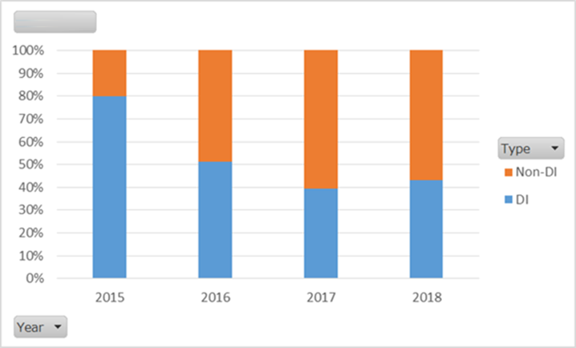
Data Integrity – Why must we comply with this? –
Since 2015, the percentage of Warning Letters related to data integrity has been decreasing!
But it is still over 40%!
Total/Count
Ratio of DI related warnings among Warning Letters
Business Year
Source: FDA website
- 7-
Notes:
This slide shows changes in the ratio of DI-related findings in warning letters issued by the FDA after inspections of drug product manufacturing sites and of drug substance manufacturing sites.
DI-related findings in warning letters have been decreasing since 2015, but as of 2018, DI-related findings still exceed 40%.
While, in early inspections, there were many findings related to document control such as data tampering and deletion, the recent findings are characterized by expansion to areas unrelated to document control, such as computer control, audit trail, and contemporaneousness of records.
So then, what is the situation in Japan?

Slide 8


Data Integrity – Why must we comply with this? –
Increasingly, the findings from PMDA’s GMP inspections cite deficiencies in document control and records.
Compliance with data integrity is basically routine for GMP activity . . . But still deficiencies are being observed.
Corporate compliance with data integrity is inadequate!!
In particular, from 2016 to 2017, “deficiencies in document control and records” which is the top finding have increased rapidly from 25 cases to 41 cases.
2017 "GMP Case Study Meeting"
From the lecture by PMDA.
- 8 -
Notes:
In Japan, at the "GMP Case Study Meeting" held in 2017, PMDA reported that deficiencies in document control and records were increasing among the findings of GMP inspections conducted by PMDA. They also reported a sharp increase was observed in deficiencies in document control and records, from 25 in 2016 to 41 in 2017.
The report states that "compliance with data integrity is basically routine GMP activities, however, it is inadequate at these companies"!

Slide 9

Data Integrity – Why must we comply with this? –
If compliance with data integrity is neglected . . .
In some cases, a product recall occurs and the company loses a great deal!
Expenses incurred in recall and compensation (economic loss)
Corporate reliability (loss of social credibility, fall in stock prices)
Markets for the product (and other products as well) (reduction/loss of share), etc.
⇒ Depending on the cause of the recall, patients' lives may be endangered!
- 9 -
Notes:
What will happen if compliance with data integrity is neglected?
If it is, it will not be possible to guarantee the quality of the products manufactured and marketed by the company. In some cases, this would lead to a recall of the products, with major losses for the company.
The major losses include the cost of recalls and compensation (economic loss), the company’s credibility (loss of social trust, fall in stock prices), and the markets (decrease/loss of share). Because our products are pharmaceuticals, patients' lives might be endangered depending on the cause of recall.

Slide 10
Data Integrity – Why must we comply with this? –
If compliance with data integrity is neglected . . .
"Bill for Partial Revision of the Act on Securing Quality, Efficacy and Safety of Pharmaceuticals, Medical Devices, Regenerative and Cellular Therapy Products, Gene Therapy Products, and Cosmetics" (submitted in the 198th Diet [ordinary session] on March 19, 2019)
❖ Maintain a system to supervise operations at manufacturers.
❖ Clarification of which officers are responsible for pharmaceutical affairs duties (responsible officers) at manufacturers
=> Management responsibility for legal compliance will be questioned.
- 10 -
Notes:
The Bill for Partial Amendment of the Act on Securing Quality, Efficacy and Safety of Pharmaceuticals, Medical Devices, Regenerative and Cellular Therapy Products, Gene Therapy Products, and Cosmetics (submitted to the 198th (ordinary) session of the Diet on March 19, 2019) newly includes clauses related to the establishment of a system for compliance with laws and regulations to ensure reliability, and also has provisions requiring license holders to establish systems to oversee manufacturers (including the establishment of a system for supervision of operations, the clarification of the responsibilities of management personnel and site managers, etc.). If this bill is enacted into law, management may be held accountable for compliance.

Slide 11
Data Integrity – Why must we comply with this? –
Company Name | Discovered in | Items involved | Misconduct committed in | Overview
Company A | March 2010 | Pharmaceutical product (tablets) | February 13, 2009 | Manufacturing with wrong ingredients (erroneous mixing of API and excipients) Samples were intentionally replaced during release testing.
Company B | April 2010 | Pharmaceutical product (human serum albumin preparation) | 2008 | Falsification of data in approval application dossier and manufacturing (PV) data. (Data replacement)
Company C | January 2011 | Pharmaceutical product (injection) | 2007 to 2010 | Part of the quality testing was deliberately omitted when the product was released (untested)
Company D | September 2014 | Air bag Inflator | 2000 to 2008 (2004) | Tampering with performance test data for inflator (= gas emitting device) Concealment of signs leading to rupture of parts
Company E | March 2015 | Seismic isolation rubber, etc. | (2007) March 2015 October 2015 February 2017 | Tampering with performance data for fire resistance of insulation panel Tampering with performance data for seismic isolation rubber Fraud involving rubber vibration insulator (for railway cars) Failure to test seat ring of ship valve
Company F | May 2015 | Pharmaceutical products (blood products) | 1980s to May 2015 | Blood products were manufactured by methods different from those specified in the approval dossier, and false manufacturing records were created and covered up.
Company G | October 2015 | Pile driving work | 2005 to 2015 | Data were tampered with 360 out of 3052 cases of pile driving work. A total of 2382 piles were subject to data tampering. 196 employees were involved (including 61 field managers).
Company H | April 2016 | Fuel consumption | 1991 to 2016 | Tampering with fuel consumption data for 4 types of light automobiles Submission of fraudulent data as part of re-measurement data
Company I | September 2017 | Invalid inspections | Past 38 years | Inspection by unqualified inspectors
Company J | September 2017 | Invalid inspections | Past 30 years | Inspection by unqualified inspectors
Company K | October 2017 | Aluminum products | 1970s to October 2017 | Data tampering for product inspection certificates and omission of inspection process
Company L | November 2017 | Semiconductor parts | June to October 2017 | Laboratory data tampering, non-inspection, concealment
Company M | November 2017 | Tire cords Automobile hoses | April 2008 to September 2016 | Product inspection data tampering 149 cases
Company N | March 2018 | Fuel consumption and exhaust gas | 2013 to 2018 | Tampering with fuel consumption and exhaust gas measurement data
Company O | July 2018 | Exhaust gas | 2013 to 2018 | Tampering with exhaust gas measurement data for 19 types of automobiles
Company P | September 2018 | Fuel consumption and exhaust gas | 2000 to 2008 | Tampering with exhaust gas measurement data and fuel consumption data in pre-shipment inspection
Company Q | October 2018 | Seismic isolators/vibration control devices (Hydraulic dampers) | February 2001 to September 2018 | Product inspection data tampering 995 seismic isolators, 110 vibration control devices
Company R | June 2018 November 2018 | Industrial lead storage batteries Semiconductor materials and 29 other products | 1970s to 2018 | Product inspection data tampering
Cases of DI-related
scandals
in the past 10 years
- 11 -
Notes:
This is a summary of DI-related scandals at major companies that have come to light in Japan in the past 10 years. There are more than a few famous major companies among them.
What backgrounds led them to such scandals?
According to new reports, the backgrounds includes such factors as "increased burden on site operators to observe strict deadlines and reduce costs," "insufficient attention to work because of personnel shortages," "lack of governance (corporate governance) represented by weakening of internal auditing functions," and "unclear roles and responsibilities of management personnel or managers." It would have to be said that dark shadows lurk behind these fraudulent practices: "The thought that the users will not know even if we do commit fraud," "an environment in which employees are numbed by long years of perpetuating the practice and no longer see it as a problem," "a workplace atmosphere that does not allow for raising issues," and "self-protection, organization protection“.
Is our company OK? Do any of the following things happen at our company?
If a product manufactured in the plant is discarded due to an operation error by a person in charge of the work, don’t you, an executive manager, reprimand the plant manager? Doesn’t the plant manager then reprimand the person in charge who made the work error and his or her supervisor? The people in charge at manufacturing sites have very few opportunities to be praised by the management, but it is a sure bet that the person in charge will be reprimanded if a product has to be disposed of due to his/her mistake. To put it bluntly, people at manufacturing sites are in an environment where they are rarely rewarded if they try hard but are blamed if they fail. Let’s imagine that, in such an environment, test results for a certain product have become nonconforming, making the plant to discard the product. What will the person in charge think under such circumstances? Reflecting on the tight delivery deadlines and the shortage of manpower to allocate to re-manufacture, he or she may become convinced that rewriting the results is the way to go. "That way, we can avoid discarding the product. Neither I nor my supervisor will be blamed, and the company will not suffer a loss . . . All I have to do is rewrite the record in front of me. . ."
However, the drugs and other products that we manufacture and sell are sent to the market on the premise of a trusting relationship between our company and the patients and medical institutions, and acts that disregard data integrity, such as data (record) tampering, betray the trust of those patients and medical institutions. Accordingly, these are things we must never do.
It goes without saying that the corporate system that allowed each of the companies in this table to neglect DI inflicted significant damage on users of the company's product (including services). Moreover, it is still fresh in the memory that there have been cases where the social responsibility of these companies has been called into question, and a dark shadow was cast over the company’s business status and human resources, ultimately threatening its very existence.

Slide 12

Data Integrity – Why must we comply with this? –
By what route do you aim to reach the mountaintop? And what will you do on the way?
Construction of a quality management system
Compliance system
D I
D I
D I
D I
D I
D I
D I
D I
- 12 -
Notes:
Once we construct an advanced quality management system and a compliance system befitting of the times, our employees will no doubt follow those procedures when performing their daily work. However, the motivation to head for higher ground seems to be lacking. This is why, when the resources needed to maintain the quality management system (= people, materials, money) are cut or excessive quotas are imposed, a pattern may develop where employees sacrifice quality in order to meet the expected productivity (= product inventory).
But even if an advanced "quality management system" and "compliance system" was established, scaling a steep slope, insurance against backsliding can be obtained by driving in spikes called data integrity at important points along the route. On the other hand, should we be negligent about data integrity, we may tumble down the slippery hillside to the foot of the hill even if a gentle slope is selected. This could expose the company to losses on every part of operation, including the cost of recalls and compensation (economic loss), the loss of the company’s credibility (loss of social trust, fall in stock prices), and the loss of markets for not only related products but also non-related products of the company (decrease/loss of share).
It doesn’t take much to send a climber sliding down a mountain. However, if the route is maintained through compliance with data integrity on a routine basis, the climbers will be able to hold their ground without backsliding, and it will be possible for them to set their sights on new heights.
A number of the major companies shown on the previous slide were examples of companies that had neglected compliance with data integrity. These may be just the tip of the iceberg. Once quality is sacrificed, what awaits us when we fall to the bottom is the reality that users have been made into victims and social credibility has been lost.
Ensuring data integrity is critical in preventing quality from being sacrificed.

Slide 13
Table of Contents
Data Integrity - Why must we comply with this? –
Image and Definition of Data Integrity
Data Governance Systems
Organizational Impact
General Impact
Code of Ethics and Quality Culture
PQS Elements

Slide 14
Image and Definition of Data Integrity (1)
Organizational Impact
Data Governance Systems
Data Integrity
Creation of a transparent and open workplace environment (quality culture) where employees can freely communicate failures and mistakes, including those that involve data reliability, and can take corrective and preventive action
Management review and approach using quality risk management as components of Pharmaceutical Quality System (PQS)
Ensuring the reliability of data throughout the data lifecycle
Key Points
Management is responsible for establishing a data governance system and fostering a quality culture to ensure data integrity
Notes:
This slide shows an image of data integrity.
In order to ensure the reliability of data throughout the data lifecycle, it is necessary to turn the blue gear to secure "Data Integrity”. For this, we need to turn the green gear of the "Data Governance System," which has the Pharmaceutical Quality System (PQS) as a constituent element. To turn the green gear further, we need to foster a quality culture in order to turn the yellow "Organizational Impact" gear.

Slide 15
Image and Definition of Data Integrity (2)
Data Integrity: The extent to which all data are complete, consistent and accurate throughout the data lifecycle
Data Lifecycle: All phases in the life of the data (including raw data) from initial generation and recording through processing (including transformation and migration), use, data retention, archiving/retrieval and destruction
Accuracy
Generation/Recording
Use
Retention
Archiving & retrieval
Destruction
Processing (including analysis/conversion/migration)
High
Data Integrity
Data Lifecycle
Key Points
Data integrity should be ensured throughout the data lifecycle
Low
Notes:
This slide illustrates the definition of data integrity.
The blue arrow indicates the lifecycle of data, wherein data must be controlled from the time of data generation and recording to destruction.
As the two-way arrow on the right shows, data integrity depends on the degree of accuracy throughout the lifecycle.

Slide 16
Data Governance Systems (1)
Data Governance: The sum total of arrangements to ensure that there is data, irrespective of the format in which it is generated, is recorded, processed, retained and used to ensure a complete, consistent and accurate record throughout the data lifecycle
Generation/Recording
Use
Retention
Archiving & retrieval
Destruction
Processing (including analysis/conversion/migration)
Accuracy
Data Lifecycle
High
Data Integrity
User authorization | Audit trail review | Product Release | Filing | Control of document storage cabinets | Procedure for record destruction
Rules for entering GMP records | CSV | Application dossier | Setting of record retention periods | Data server management
Low
Data governance
Notes:
As shown in the previous slide, what is important in data integrity is that all data are complete, consistent and accurate throughout the data lifecycle.
This means that the data, including raw data, must be complete, consistent and accurate at all phases of the data life, from the time of initial generation and recording which entails processing (including transformation and migration), through use, retention, archiving/retrieval, and destruction.
In other words, it is important that data governance be working properly at all times throughout all processes, from the generation of the data to destruction, as shown in this slide.
This does not simply mean that data must be generated correctly. We must also be able to provide a coherent explanation that it was correctly generated, retained, and destroyed.

Slide 17
Data Governance Systems (2)
Data governance system: System to achieve data governance integrated into Pharmaceutical Quality System (PQS)
Key Points
It is the responsibility of management to implement a data governance system that ensures data integrity.
Data Integrity
Data Lifecycle
Documentation as an element of PQS
Data governance
PQS
Data governance systems
Review and reconsideration of the data governance system
PQS elements
CAPA system
Change management
Management review
• Data criticality
• Data risk
Method for achievement
Quality Risk Management
Notes:
There is a need to construct an effective governance system that guarantees data integrity, covering data, matters related to such data, environment, and allocation of resources etc.
The data governance system is an element of the pharmaceutical quality system, and it is the responsibility of the management to implement data governance as an aspect of the pharmaceutical quality system.
It is very important for the company to review and reconsider data governance as an element of the pharmaceutical quality system in order to ensure data integrity.

Slide 18
Organizational Impact on Data Integrity
Data Integrity
PQS
Data governance systems
Quality risk
management
Responding to data integrity issues
Periodic management review of quality metrics
Resource allocation
Quality Culture
Ethical standards and policies
Notes:
This slide shows the organizational impact on data integrity.

Slide 19
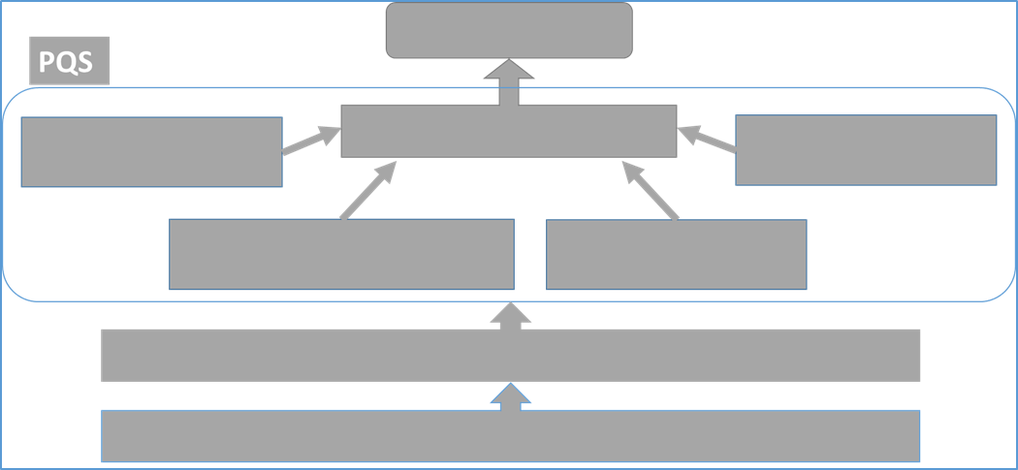
General Impact
Key Points
Management needs to understand the following:
• Legal and moral responsibility to prevent and detect loss of data integrity
• The direct and indirect* risk factors that impact data integrity and how to deal with them
*: For example, incentives for production exceeding process capability
Management "awareness and comprehension" of data integrity
Impact on successful management of data integrity
Data Integrity
Risk Management
Data governance systems
Responding to data integrity issues
Periodic management review of quality metrics
Resource allocation
Quality Culture
Ethical standards and policies
Notes:
The true quality of drugs cannot be grasped by patients and medical institutions and not even by employees of the pharmaceutical plant.
As mentioned earlier, the drug products that are delivered to the patients are only tested for appearance (destructive testing is not possible).
The quality of drugs is assured only with various records, such as manufacturing and testing records.
The accuracy and correctness of records related to drugs can be considered a commitment to patients and other stakeholders.

Slide 20
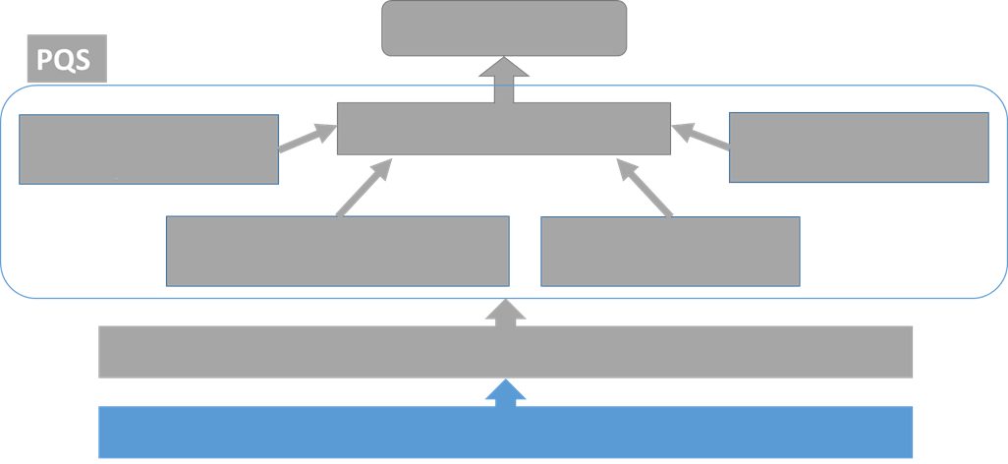
Ethical Standards and Policies
Key Points
Management needs to understand the following:
• Documentation of values, ethics and codes of conduct
• Informing employees on what roles they play in data integrity, product quality assurance and patient safety, and how important those roles are
• Including in the Code of Conduct examples of actions unfavorable to the integrity of the data and how such actions are handled
• Establishment of a whistle-blowing system for data integrity
Data Integrity
Risk Management
Data governance systems
Responding to data integrity issues
Periodic management review of quality metrics
Resource allocation
Quality Culture
Ethical standards and policies
Creating an environment of trust that reflects management philosophy on quality, in which all employees are responsible for ensuring patient safety and product quality
Notes:
Management should demonstrate ethical standards, such as giving top priority to patient protection and attaching great importance to quality.
It is also the role of management to establish an internal culture that is deeply concerned with quality and sees it as vital.
Quality assurance is the absolute mission of a pharmaceutical company, and we need to be aware that the daily words and behavior of the management have a strong influence on the quality culture of the organization.
The quality of records is tantamount to the quality of drugs, and management is responsible for supporting the organization to ensure that a quality culture takes root.
The guidelines require that a hotline or other appropriate whistle-blowing system be available for cases where there is a possibility that senior management has violated the Code of Conduct.

Slide 21
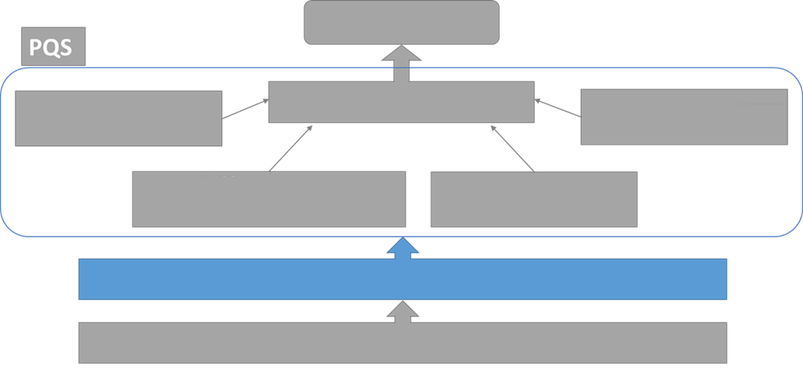
Quality Culture
Key Points
Management needs to understand the following:
• Maturing Quality Culture
• Organizational reporting structure where information can be shared among employees at all levels
• Involvement of management itself in the maturing of Quality Culture
Data Integrity
Quality Risk Management
Data governance systems
Responding to data integrity issues
Periodic management review of quality metrics
Resource allocation
Quality Culture
Ethical standards and policies
Transparent and open workplace where all employees can freely communicate failures and mistakes
Notes:
Organizational climate is an important factor in managing data integrity. Closed workplaces where incident reports are blocked or bound by the organizational hierarchy are more susceptible to manipulation or intentional deletion of data. Management should therefore create a transparent and open working environment (i.e., quality culture) where all employees can freely communicate failures and errors, including data reliability issues, and ensure that the organizational reporting structure enables information to be shared among employees at all levels.
The quality culture is nurtured, to some extent, also through employee's voluntary activities, but it needs to be understood that management involvement can have a significant impact. This means that management will need to make certain that employees know what is expected of them (including the image of what they should be), and to this end, management should set an example through its own behavior. It also means allocating resources as needed and implementing fair and equitable rewards and penalties to promote the reshaping of consciousness that is needed in order to ensure data integrity.

Slide 22
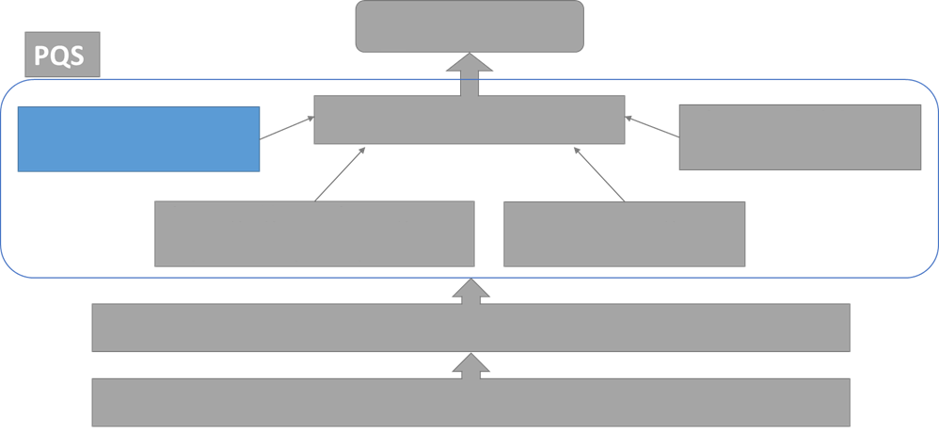
PQS Elements: Quality Risk Management
Key Points
Management needs to understand the following:
• Application of Quality Risk Management and appropriate data control standards to PQS
• Development of PQS to address complex data generation issues
• PQS should be able to prevent/detect/correct data integrity risks.
Data Integrity
Quality Risk Management
Data governance systems
Responding to data integrity issues
Periodic management review of quality metrics
Resource allocation
Quality Culture
Ethical standards and policies
Applying Quality Risk Management and good data management practices to PQS
Notes:
The application of the concept of risk management and good data management practices to the traditional Pharmaceutical Quality System (PQS) will lead to enhancement of the company’s system for dealing with the issues that accompany the generation of complex data.
The Pharmaceutical Quality System (PQS) should be capable of guarding against, detecting, and correcting vulnerabilities in systems and processes that cause failures in data integrity. With a good grasp of the lifecycle of data, it is then necessary to integrate appropriate control methods and procedures to ensure the validity, integrity and reliability of the data obtained.

Slide 23
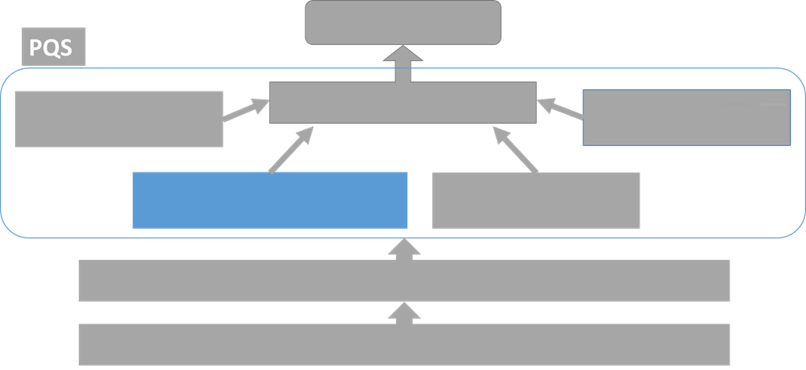
PQS Elements: Periodic Review of Quality Metrics
Key Points
Management needs to understand the following:
• Periodic review of performance indicators; and identification, escalation and addressing of significant events
• Selection of appropriate performance indicators that do not reduce the priority of data integrity
• Direct communication about risks to senior management by head of quality unit
Data Integrity
Quality Risk Management
Data governance systems
Responding to data integrity issues
Periodic management review of quality metrics
Resource allocation
Quality Culture
Ethical standards and policies
Management reviews quality metrics on a regular basis to identify, escalate and address significant events
Notes:
Next, we will talk about periodic management review of performance indicators, including quality metrics.
Management is required to conduct periodic management reviews on performance indicators, including those related to data integrity, to detect and correct significant issues.
An independent department or expert may be asked to periodically verify the effectiveness of the system or control procedure.
When establishing quality metrics and evaluation methods, care should be taken to avoid creating a climate in which low priority is given to data integrity.
In addition, a system needs to be constructed so that the head of the quality unit can escalate risks directly to management and management can recognize the risks and allocate resources for addressing problems.

Slide 24
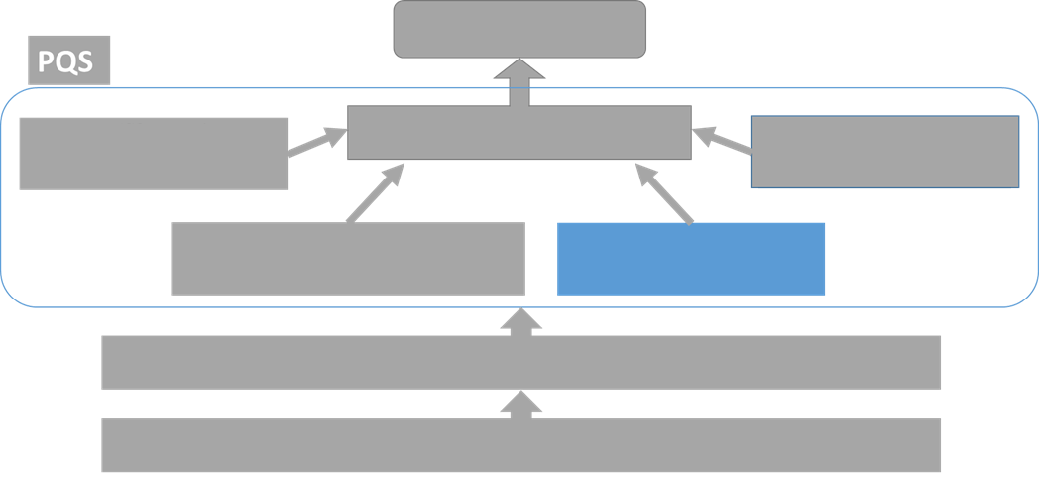
PQS Elements: Resource Allocation
Key Points
Management needs to understand the following:
• Allocation of resources so that excessive workloads or pressure do not create data integrity issues
• Securing sufficient personnel necessary for management oversight, IT support, etc.
• Purchase of equipment, software, etc. necessary for complying with ALCOA + and fulfilling data integrity requirements, and implementation of education for employees
Data Integrity
Quality Risk Management
Data governance systems
Responding to data integrity issues
Periodic management review of quality metrics
Resource allocation
Quality Culture
Ethical standards and policies
Allocating appropriate resources to enable employees to continuously manage data integrity
Notes:
Next we will consider resource allocation.
Management should allocate adequate resources to support and maintain the management of data integrity so that errors and intentional loss of data integrity are not invited by inadvertently or deliberately imposing excessive workloads and pressure on the persons responsible for data generation and record storage.
Staff allocation should allow for sufficient IT support, oversight/auditing, and training for employees. We also need to improve the level of compliance with ALCOA + within the company. ALCOA+ means that data must be Attributable, Legible, Contemporaneous, Original, Accurate, Complete, Consistent, Enduring, and Available. To this end, we must construct systems or mechanisms that enable us to purchase the equipment, software, and hardware necessary to overcome any weaknesses in data integrity. To familiarize all employees with the quality and integrity of the data and to promote risk discovery and improvement, we are expected to enlist the assistance of experts (SMEs, supervisors, team leaders, etc.) at various levels. In addition, we are required to assign persons to play roles in data management within the organization, such as data managers and persons in charge of compliance.

Slide 25
PQS Elements: Handling Data Integrity Issues
Key Points
Management needs to understand the following:
• Evaluation of impact on product quality should be based on scientific evidence.
• Loss of data integrity should be handled as a PQS deviation, and root cause investigation and CAPA should be performed.
• Corrective actions for deviations should include reporting to authorities and notifying customers when necessary.
Data Integrity
Quality Risk Management
Data governance systems
Responding to data integrity issues
Periodic management review of quality metrics
Resource allocation
Quality Culture
Ethical standards and policies
Handle as a PQS deviation
Notes:
Next we will consider how to deal with data integrity issues found internally.
Any data integrity issue that is found should be treated as a "deviation" under the Pharmaceutical Quality System (PQS).
Evaluation of the impact on product quality is based on scientific evidence. If a defect is found, it is necessary to investigate the scope and root cause of the problem, take corrective actions, and take preventive actions. The implementation of gap analysis to discover system weaknesses is an effective measure within this process. Corrective actions include product recall, customer notification, and regulatory reporting. Management is required to monitor the planning and implementation of corrective actions and document the series of activities involved.

